Slide 1
The Autonomous Flight Systems Laboratory External Demo Sprint 1410
November 10, 2014

Slide 2
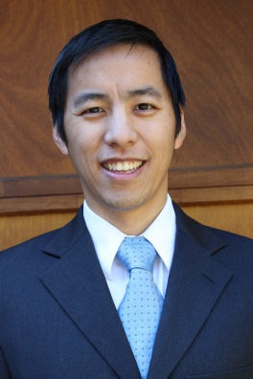
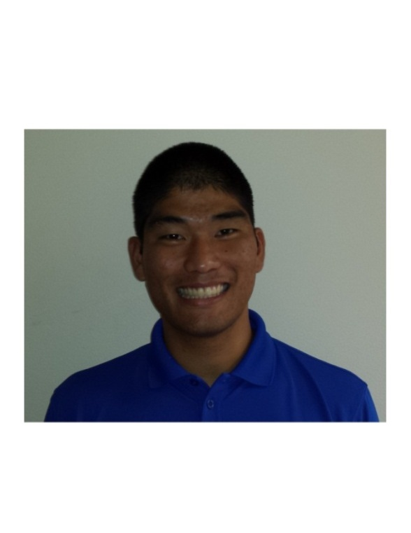
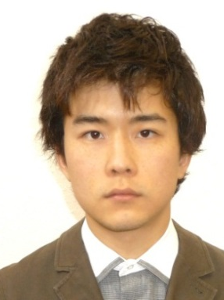
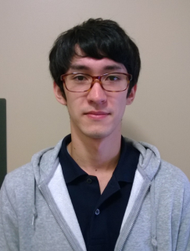
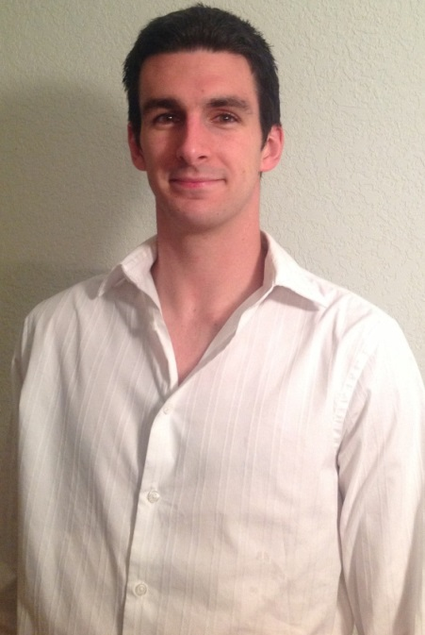
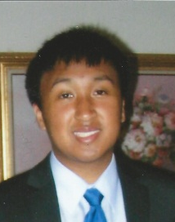
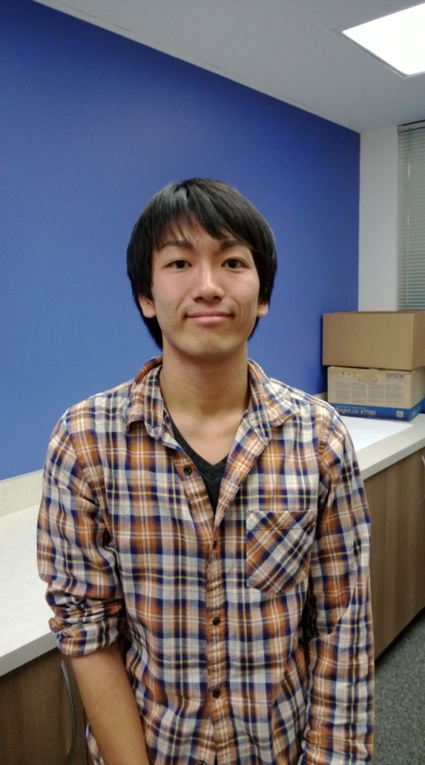
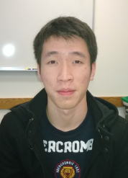
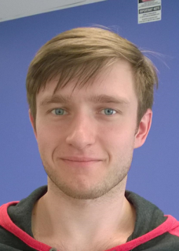
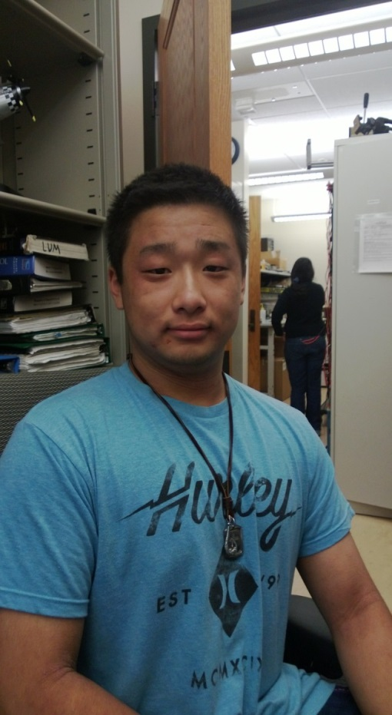
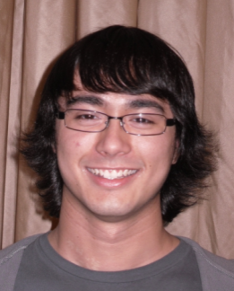

Team Introduction
Christopher Lum
Research Scientist
Lt. Kevin Ueunten
Masters Student
Noel Kimber
Senior
Dai Tsukada
Senior
Al Creigh
Junior
Daniel Ablog
Junior
Keisuke Tsujita
Junior
Brian Chang
Junior
Aleksandr Tereshchenkov
Junior
Henry Qin
Sophomore
Justin Yantus
Sophomore
Ryan Valach
Sophomore
University of Washington
2

Slide 3
Team Introduction
33 developers
1 research scientist
7 graduate students (unsupported)
25 undergraduates
Wide range of disciplines (AA, EE, ME, applied physics, etc.)
University of Washington
3

Slide 4
User Story Overview
ICOMC2 CAPlugin Team
 | Committed Stories |  | Stretch Stories
 | Number of Stories | Total Story Points | Number of Stories | Total Story Points
Accepted Status | 45 | 132 | 0 | 0
Descoped Status | - | 83 | - | -
Impeded Status | 7 | 21 | 0 | 0
Total: | - | 236 | - | -
Did not record number of descoped stories but we obtained the point values.
Large number of these are training user stories as new students become familiar with procedures and policies.

Slide 5
User Story Progression
Average of 4 points accepted per developer (20 hr/week).
Average of 2.5 points descoped per developer (~ 60% too ambitious)
Historically this is fairly high in terms of productivity.

Slide 6
331 – Visual Anchoring: RCAM Plant Model
Development Champion: Christopher Lum
Content
As a simulation engineer, I would like to create a plant model of an aircraft (based on the RCAM model) so that I can use it for simulation and other components.
Definition of Done
[x] Obtain 6DOF model from Chris Lum
[x] Get this model to run on a local build
[x] Port this block to the Simulink library file for the project (see 283 – ScanEagle Simulator: System Architecture)
[x] Study the model and see how to modify it for different aircraft.
[x] OPTIONAL: Coordinate with members of the ADV-CTRL lab in the AA department to determine if they have plants/controllers available

Slide 7
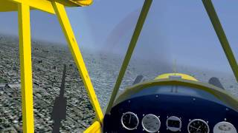
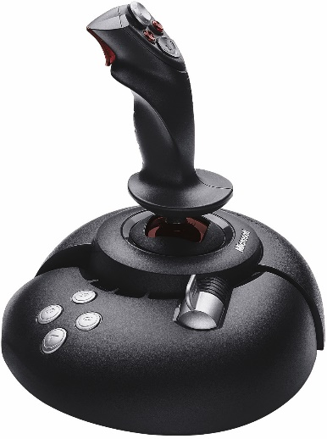

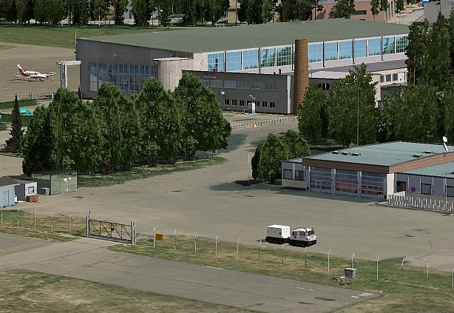
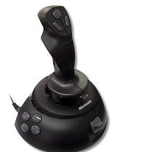
Overview
Aircraft State Visualization
FlightGear 0.9.8
Aircraft Joystick
Aircraft Plant Simulation
Matlab/Simulink
Payload Joystick
Payload Visualization
X-Plane 9

Slide 8
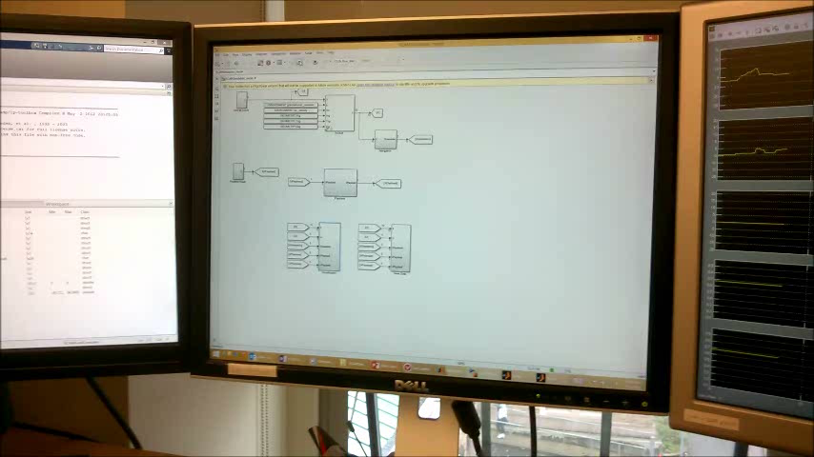
Movie

Slide 9
308 – Autopilot Simple Demonstration
Development Champion: Alec Bueing
Content
As a researcher and marketing representative, I would like to create a simple demonstration of the autopilot to illustrate how the system can be used in a real world, engineering application.
Definition of Done
[x] Coordinate with development champion(s) of user story ’309 – Simple Camera System Familiarization (position 1)’
[x] Write a document which describes the desired demonstration. This demonstration should exercise system components in a fashion similar to how it will be used in the real system.
[x] Setup system to perform this demo and gather data from the experiment.
[x] Present experimental results to the group.
[x] Conduct a live demo with the group.
[x] Document is checked into Perforce in appropriate location.

Slide 10
APM 2.6 Capabilities
Telemetry Data
Flight logging
Manual / Semi-manual modes
Pure RC mode
Stabilized mode
Fly-by-wire modes
Autonomous Modes
Take-off
Waypoints
Loiter
Return-to-launch
Landing

Slide 11
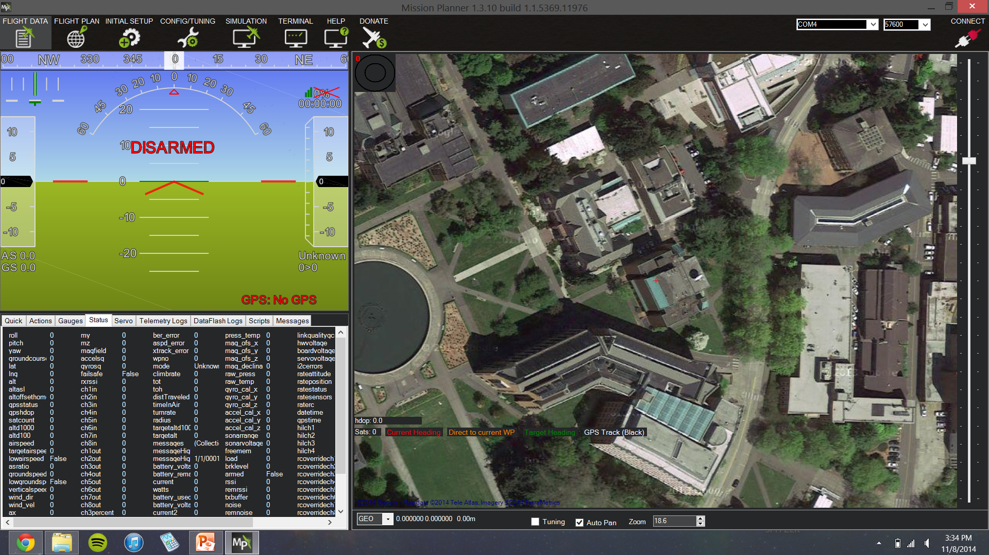
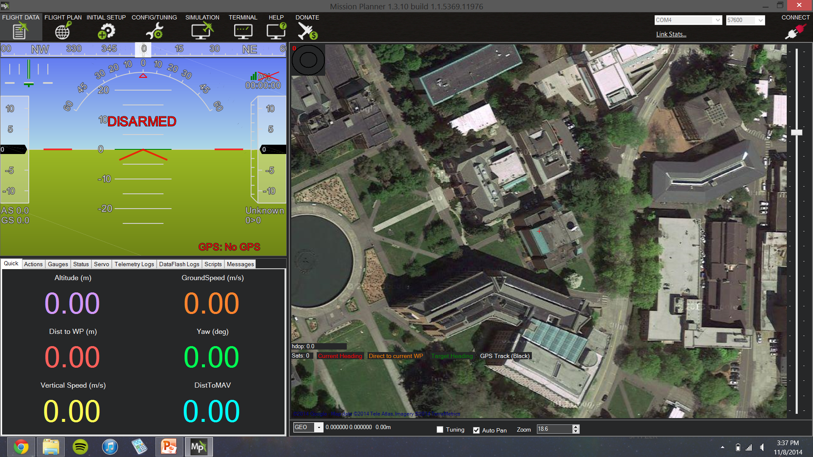
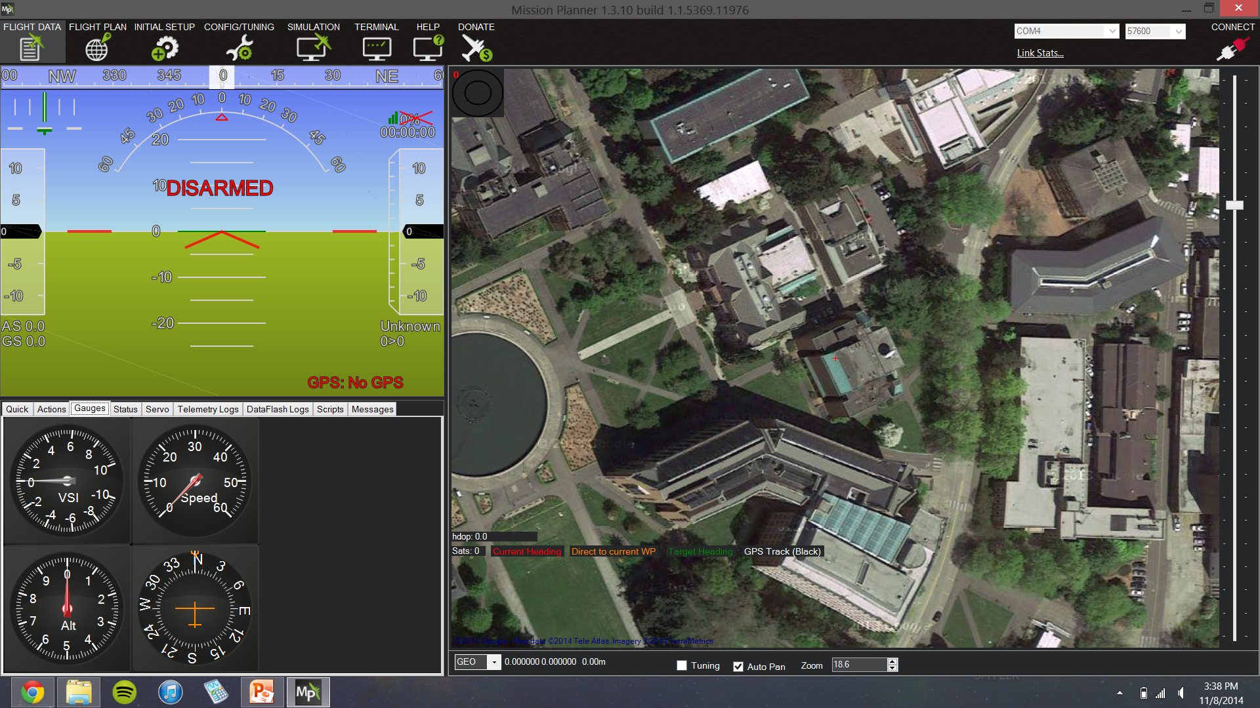
Data Acquisition & Logging
APM provides operator with all useful information in flight
Flight data can be recorded through mission planner

Slide 12
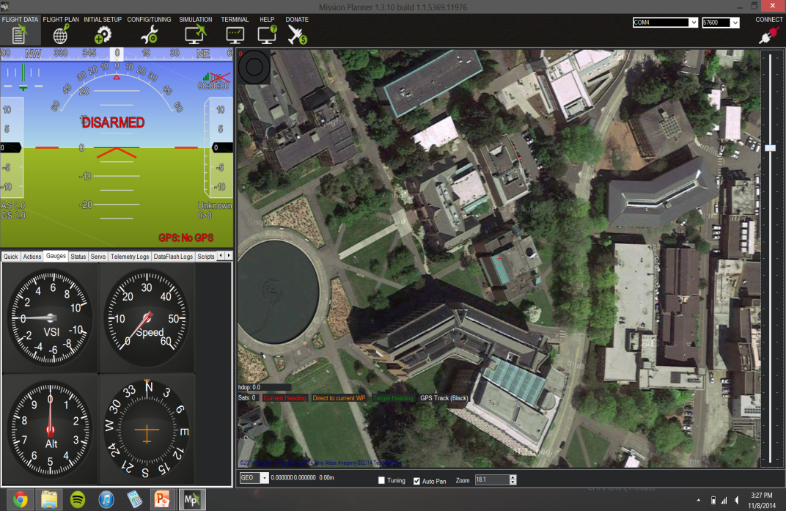
Manual Flight Modes
Pure RC control: APM is completely passive
Stabilize Mode: aircraft levels out when no controls are actively manipulated
Fly-by-wire: aircraft holds orientation (bank & pitch angles) after controls are released
Shows telemetry even
when passive

Slide 13
Autonomous Modes
Take-off (works better for aircraft with landing gear)
Waypoints: aircraft will follow path of pre-set waypoints from mission planner software
Loiter: aircraft will circle to hold position over a specified location
Return-to-launch: aircraft returns to location of launch (functions as failsafe)
Landing (works regardless of landing gear)

Slide 14
321 – Pan/Tilt Gimbal System Creation
Development Champion: Brendan Doyle Wade
Content
As a project engineer, I would like to create a pan/tilt gimbal system for the UW UAS so that I can mount the camera on it and enable the camera to pan/tilt independently from the aircraft.
Definition of Done
[x] Discuss with Chris Lum before starting project.
[x] Research if an off-the-shelf component can be purchased which meets our needs.
[x] Design a pan/tilt gimbal system that will allow the camera to pan/tilt independent of the aircraft body.
[x] Manufacture this system.
[x] Test system on lab bench (do not mount on aircraft).
[x] Mount system on aircraft and test.
[x] Demonstrate functionality of pan/tilt gimbal system to research group.
[x] Check in all research, design, and usage documents into appropriate location in Perforce.

Slide 15
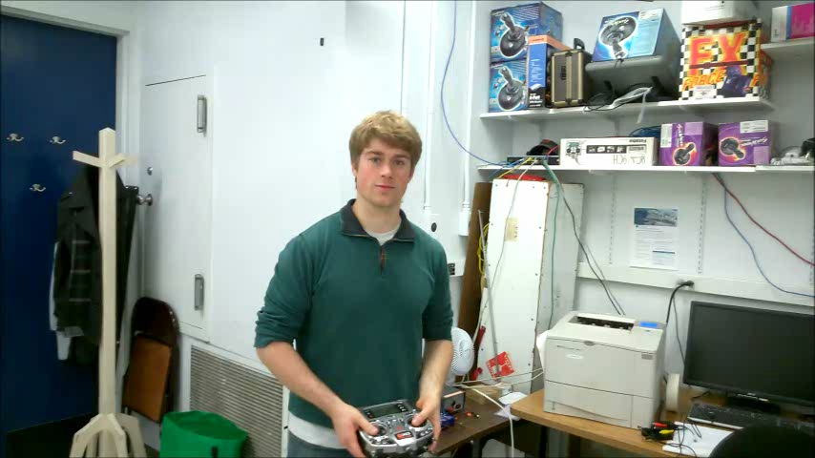
Overview

Slide 16
Not Demoable Accepted User Stories
JCATI Collision Awareness
295 – Error Propagation Bug | L | Kevin Ueunten
296 – IEEE Aerospace Conference Paper Writeup | XL | Kevin Ueunten
298 – Master’s Thesis 2 | XL | Kevin Ueunten
391 – IEEE Paper Review and Write Introduction | M | Al Creigh
392 – IEEE Paper Review | M | Keisuke Tsujita
459 – UW-TV Interviews and Filming | M | Christopher Lum
General AFSL Lab
381 – UW Engineering Societies Fair | XS | Christopher Lum
397 – LaTeX Environment Setup | M | Brian Chang
410 – Tabulate UW Course Evaluation Data | S | Dana Fraij
433 – Piper J-3 Training RC Aircraft Setup | M | Mason Steinbrueck
434 – Aircraft Storage and Display | XS | Christopher Lum
452 – Developer WebEx Account Setup (Copy) | XS | Hao Ruan

Slide 17
Not Demoable Accepted User Stories
Flight Operations
311 – Simple Camera System Documentation | L | Keisuke Tsujita
314 – Simple Camera System Familiarization (Advanced) | M | Keisuke Tsujita
324 – Aircraft Flight Testing Preparation and Legalities (RC Config) | XL | Melanie Clark
326 – Laboratory Setup (Part 2) | M | Christopher Lum
334 – Laboratory Safety | M | Aleksandr Tereshchenkov
335 – Coordinate with Earth and Space Sciences | M | Christopher Lum
337 – Sprint 1410 Administration | L | Christopher Lum
384 – APM Firmware Preparation/Installation | M | Alec Bueing
403 – UW UAS Wind Tunnel Test Feasibility Study | M | Aleksandr Tereshchenkov
414 – Backup Airframe Procurement and Construction | M | Justin Yantus
416– UW UAS Systems Audit | M | Brendan Doyle Wade
418 – Backup Airframe Procurement and Construction (Position 2) | M | Maxine Tan
425 – APM Data Logging | L | Justin Taft
Visual Anchoring
330 – Visual Anchoring: System Architecture | S | Christopher Lum
395 – Visual Anchoring Literature Review | M | Henry Qin
402 – Visual Anchoring Literature Review (copy) | M | Ryan Valach
431 – Visual Anchoring Literature Review (copy) | M | Ben Landes

Slide 18
Next Steps (Sprint 1411 Plans)
Flight testing of visual anchoring aircraft.
Trim and linearize system about orbit trajectory.
Development prototype orbit controller
Investigation of computer vision and image processing SDKs.
Discuss with Dr. Rolf Rysdyk about orbit controller architecture.
QUESTIONS?

